Slide 1
Object Detection

Slide 2
So Far: Image Classification
Class Scores
Cat: 0.9
Dog: 0.05
Car: 0.01
...
CNN (feature computation, e.g., AlexNet)
Fully-Connected:
4096 to 1000
Vector:
4096
Vector:
1000
Source: Johnson
Notes:
Image classification: a single category label to each image. This is one vision task.
Other tasks: object detection,

Slide 3
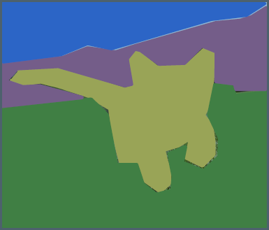
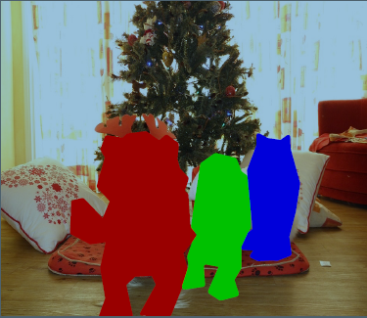
Vision Tasks
Semantic
Segmentation
Object
Detection
Instance
Segmentation
Classification
CAT
GRASS, CAT, TREE, SKY
DOG, DOG, CAT
DOG, DOG, CAT
No spatial extent
No object, just pixels
Multiple objects
Source: Johnson
Notes:
Image classification
Object detection: category label + bounding box (giving the spatial extent of the object) for each of the objects in a fixed set of categories)
Semantic segmentation
Instance segmentation
Panoptic segmentation

Slide 4
Object Detection: Task Definition
Input:
Single RGB Image
Output:
A set of detected objects;
For each object predict:
Category label (from fixed, known set of categories)
Bounding box (four numbers: x, y, width, height)
Source: Johnson
Notes:
E.g., CIFAR10, the model is aware of 10 fixed categories.
In ImageNet 1000 fixed categories.
Boxes are axis aligned.
Differences:
Multiple outputs
Box coordinates for each of the above
Relatively high resolution images in contrast to 224 x 224.
Resolution is usually 600 x 800: much larger image sizes. Less images for batch. Computationally expensive.
Applications: self-driving car.

Slide 5
Object Detection: Challenges
Multiple outputs: Need to output variable numbers of objects per image
Multiple types of output: Need to predict “what” (category label) as well as “where” (bounding box)
Large images: Classification works at 224x224; need higher resolution for detection, often ~800x600
Source: Johnson
Notes:
Variable sized number of objects.
Applications: self-driving car.

Slide 6
Detecting a Single Object
What
Correct Label
Cat
Class Scores
Cat: 0.9
Dog: 0.05
Car: 0.01
...
Softmax Loss
Often pretrained on ImgeNet (Transfer learning)
Fully-Connected:
4096 to 1000
Multitask Loss
Vector:
1000
CNN (feature computation, e.g., AlexNet)
Weighted Sum
Loss
Vector:
4096
Box Coordinates
(x, y, w, h)
Fully-Connected:
4096 to 4
L2 Loss
Treats localization as a regression problem.
Correct Box
(x’, y’, w’, h')
Problem: Images can have more than one object.
Treat localization as a regression problem.
Where
Source: Johnson
Notes:
This works only for one object in an image.

Slide 7
Detecting a Multiple Objects
Need different numbers of outputs per image
CAT: (x, y, w, h)
4 numbers
DOG: (x, y, w, h)
DOG: (x, y, w, h)
CAT: (x, y, w, h)
12 numbers
DUCK: (x, y, w, h)
DUCK: (x, y, w, h)
…
Many numbers
Source: Johnson
Notes:
Different images have different number of objects.

Slide 8
Detecting a Multiple Objects: Sliding Window
Apply a CNN to many different
crops of the image, CNN classifies
each crop as object or background
DOG? NO
CAT? NO
Background? YES
DOG? YES
CAT? NO
Background? NO
DOG? YES
CAT? NO
Background? NO
DOG? NO
CAT? YES
Background? NO
Source: Johnson
Notes:
C+1: no of classes + background.

Slide 9

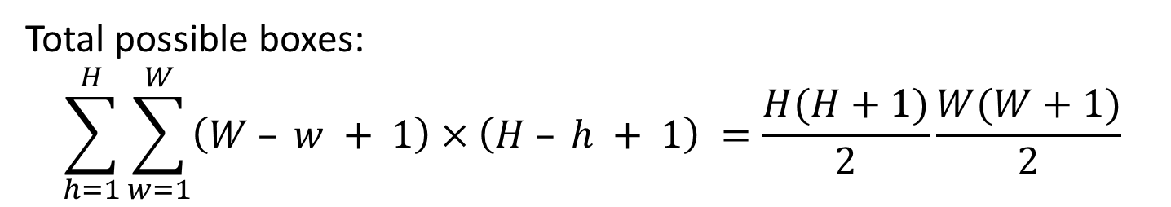
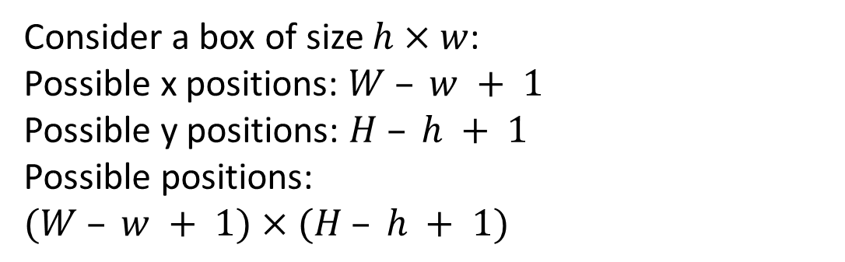
Detecting a Multiple Objects: Sliding Window
Apply a CNN to many different
crops of the image, CNN classifies
each crop as object or background
Question: How many possible boxes are there in an image of size $H×W$?
Consider a box of size $h×w$:
Possible x positions: $W – w + 1$
Possible y positions: $H – h + 1$
Possible positions:
$(W – w + 1)×(H – h + 1)$
800 x 600 image
has ~58M boxes!
No way we can
evaluate them all.
Total possible boxes:
$$\sum_{h=1}^{H}{\sum_{w=1}^{W}{\left(W – w + 1\right)×\left(H – h + 1\right) =\frac{H(H+1)}{2}\frac{W(W+1)}{2}}}$$
Source: Johnson

Slide 10
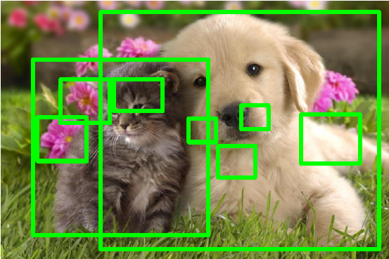
Region Proposals
Find a small set of boxes that are likely to cover all objects
Often based on heuristics: e.g. look for “blob-like” image regions
Relatively fast to run; e.g., Selective Search gives 2000 region proposals in a few seconds on CPU
Alexe et al, “Measuring the objectness of image windows”, TPAMI 2012
Uijlings et al, “Selective Search for Object Recognition”, IJCV 2013
Cheng et al, “BING: Binarized normed gradients for objectness estimation at 300fps”, CVPR 2014
Zitnick and Dollar, “Edge boxes: Locating object proposals from edges”, ECCV 2014
Source: Johnson

Slide 11
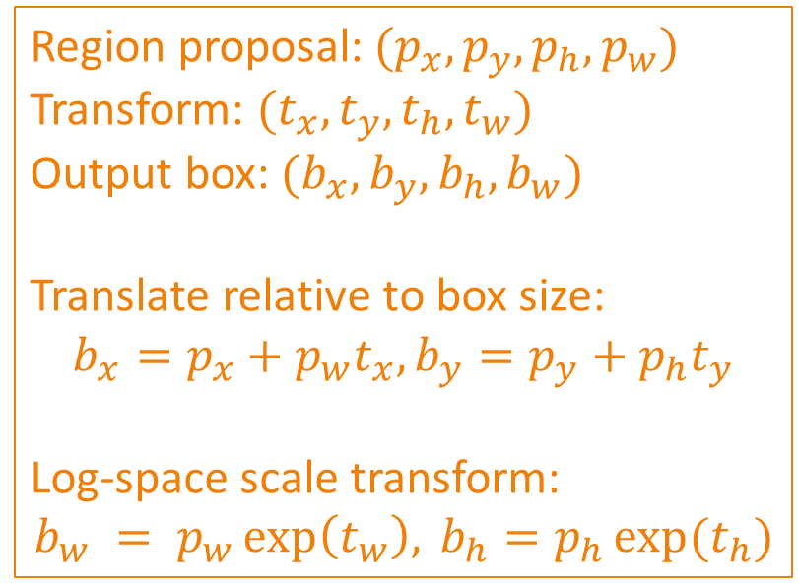
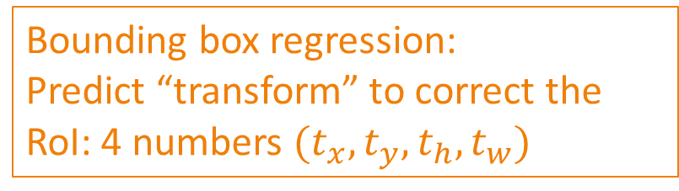
R-CNN: Region Proposals + CNN Features
Source: R. Girshick
Classify regions with SVMs
Bbox
SVMs
Bbox
SVMs
Bounding box regression:
Predict “transform” to correct the
RoI: 4 numbers $(t_{x}, t_{y}, t_{h}, t_{w})$
ConvNet
Bbox
SVMs
ConvNet
Forward each region through ConvNet
ConvNet
Region proposal:$(p_{x}, p_{y}, p_{h}, p_{w})$
Transform: $(t_{x}, t_{y}, t_{h}, t_{w})$
Output box: $(b_{x}, b_{y}, b_{h}, b_{w})$
Translate relative to box size:
$$b_{x}=p_{x}+p_{w}t_{x}, b_{y}=p_{y}+p_{h}t_{y}$$
Log-space scale transform:
$$b_{w} = p_{w}\exp\left(t_{w}\right), b_{h}=p_{h}\exp{(t_{h})}$$
Warped image regions
Region proposals
(~2k)
Input image
R. Girshick, J. Donahue, T. Darrell, and J. Malik, Rich Feature Hierarchies for Accurate Object Detection and Semantic Segmentation, CVPR 2014.
Slide: Lazebnik, Johnson
Notes:
The features are also sent to a linear regressor that improves object localization.
The components outlined in purple are “post hoc” in the sense that they are learned after the convnet weights are trained and forever frozen.

Slide 12
R-CNN: Test Time
Input: Single RGB Image
Run region proposal method to compute ~2000 region proposals
Resize each region to 224×224 and run independently through CNN to predict class scores and bbox transform
Use scores to select a subset of region proposals to output (Many choices here: threshold on background, or per-category? Or take top K proposals per image?)
Compare with ground-truth boxes
Source: R. Girshick
Bbox
SVMs
Bbox
SVMs
ConvNet
Bbox
SVMs
ConvNet
ConvNet
Input image
R. Girshick, J. Donahue, T. Darrell, and J. Malik, Rich Feature Hierarchies for Accurate Object Detection and Semantic Segmentation, CVPR 2014.
Slide: Lazebnik, Johnson
Notes:
The features are also sent to a linear regressor that improves object localization.
The components outlined in purple are “post hoc” in the sense that they are learned after the convnet weights are trained and forever frozen.

Slide 13
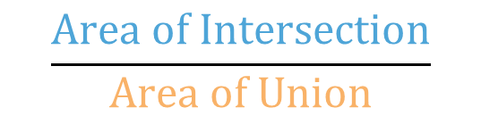
Comparing Boxes: Intersection over Union (IoU)
How can we compare our prediction to the ground-truth box?
Our Prediction
Intersection over Union (IoU)
(Also called “Jaccard similarity” or
“Jaccard index”):
IoU = 0.54
IoU = 0.71
$$\frac{Area of Intersection}{Area of Union}$$
IoU = 0.91
IoU > 0.5 is “decent”
Ground Truth
IoU > 0.7 is “pretty good”
IoU > 0.9 is “almost perfect”
Source: Johnson
Notes:
0 < IoU < 1

Slide 14
Overlapping Boxes: Non-Max Suppression (NMS)
Problem: Object detectors often
output many overlapping detections:
P(dog) = 0.9
Solution: Post-process raw
detections using Non-Max
Suppression (NMS)
1. Select next highest-scoring box
2. Eliminate lower-scoring boxes
with IoU > threshold (e.g., 0.7)
3. If any boxes remain, GOTO 1
P(dog) = 0.7
P(dog) = 0.75
IOU( , ) = 0.78
IOU( , ) = 0.05
P(dog) = 0.8
IOU( , ) = 0.07
Source: Johnson

Slide 15
Overlapping Boxes: Non-Max Suppression (NMS)
Problem: Object detectors often
output many overlapping detections:
P(dog) = 0.9
Solution: Post-process raw
detections using Non-Max
Suppression (NMS)
1. Select next highest-scoring box
2. Eliminate lower-scoring boxes
with IoU > threshold (e.g., 0.7)
3. If any boxes remain, GOTO 1
P(dog) = 0.7
P(dog) = 0.75
IOU( , ) = 0.74
Source: Johnson

Slide 16
Overlapping Boxes: Non-Max Suppression (NMS)
Problem: Object detectors often
output many overlapping detections:
Solution: Post-process raw
detections using Non-Max
Suppression (NMS)
1. Select next highest-scoring box
2. Eliminate lower-scoring boxes
with IoU > threshold (e.g., 0.7)
3. If any boxes remain, GOTO 1
Problem: NMS may eliminate ”good” boxes when objects are highly overlapping… no good solution =(
Source: Johnson
Notes:
High=overlap between objects creates trouble for NMS.

Slide 17
Evaluating Obj. Detectors: Mean Average Precision
Run object detector on all test images (with NMS) .
For each category, compute Average Precision (AP) = area under Precision vs Recall Curve
For each detection (highest score to lowest score)
Otherwise mark it as negative
Plot a point on PR Curve
All dog detections sorted by score
0.99
0.99
0.95
0.90
0.50
0.10
Match: IoU > 0.5
All ground-truth dog boxes
Precision = 1/1 = 1.0
Recall = 1/3 = 0.33
Precision
Recall
1.0

Slide 18
Evaluating Obj. Detectors: Mean Average Precision
Run object detector on all test images (with NMS) .
For each category, compute Average Precision (AP) = area under Precision vs Recall Curve
For each detection (highest score to lowest score)
Otherwise mark it as negative
Plot a point on PR Curve
All dog detections sorted by score
0.99
0.99
0.99
0.95
0.90
0.50
0.10
Match: IoU > 0.5
All ground-truth dog boxes
Precision = 2/2 = 1.0
Recall = 2/3 = 0.67
Precision
Recall
1.0

Slide 19
Evaluating Obj. Detectors: Mean Average Precision
Run object detector on all test images (with NMS) .
For each category, compute Average Precision (AP) = area under Precision vs Recall Curve
For each detection (highest score to lowest score)
Otherwise mark it as negative
Plot a point on PR Curve
All dog detections sorted by score
0.99
0.99
0.99
0.95
0.90
0.50
0.10
No match > 0.5 IoU with GT
All ground-truth dog boxes
Precision = 2/3 = 0.67
Recall = 2/3 = 0.67
Precision
Recall
1.0

Slide 20
Evaluating Obj. Detectors: Mean Average Precision
Run object detector on all test images (with NMS) .
For each category, compute Average Precision (AP) = area under Precision vs Recall Curve
For each detection (highest score to lowest score)
Otherwise mark it as negative
Plot a point on PR Curve
All dog detections sorted by score
0.99
0.99
0.99
0.95
0.90
0.50
0.10
No match > 0.5 IoU with GT
All ground-truth dog boxes
Precision = 2/4 = 0.5
Recall = 2/3 = 0.67
Precision
Recall
1.0

Slide 21
Evaluating Obj. Detectors: Mean Average Precision
Run object detector on all test images (with NMS) .
For each category, compute Average Precision (AP) = area under Precision vs Recall Curve
For each detection (highest score to lowest score)
Otherwise mark it as negative
Plot a point on PR Curve
All dog detections sorted by score
0.99
0.99
0.99
0.95
0.90
0.50
0.10
Match > 0.5 IoU
All ground-truth dog boxes
Precision = 3/5 = 0.6
Recall = 3/3 = 1.0
Precision
Recall
1.0

Slide 22
Evaluating Obj. Detectors: Mean Average Precision
Run object detector on all test images (with NMS) .
For each category, compute Average Precision (AP) = area under Precision vs Recall Curve
For each detection (highest score to lowest score)
Otherwise mark it as negative
Plot a point on PR Curve
All dog detections sorted by score
0.99
0.99
0.99
0.95
0.90
0.50
0.10
All ground-truth dog boxes
Precision = 3/5 = 0.6
Recall = 3/3 = 1.0
How to get AP = 1.0: Hit all GT
boxes with IoU > 0.5, and have no
“false positive” detections ranked
above any “true positives”
Precision
Dog AP = 0.86
Recall
1.0

Slide 23
Evaluating Obj. Detectors: Mean Average Precision
Run object detector on all test images (with NMS) .
For each category, compute Average Precision (AP) = area under Precision vs Recall Curve
For each detection (highest score to lowest score)
Otherwise mark it as negative
Plot a point on PR Curve
Mean Average Precision (mAP) = average of AP for each category
Car AP = 0.65
Cat AP = 0.80
Do AP = 0.86
mAP@0.5 = 0.77

Slide 24
Evaluating Obj. Detectors: Mean Average Precision
Run object detector on all test images (with NMS) .
For each category, compute Average Precision (AP) = area under Precision vs Recall Curve
For each detection (highest score to lowest score)
Otherwise mark it as negative
Plot a point on PR Curve
Mean Average Precision (mAP) = average of AP for each category
For “COCO mAP”: Compute mAP@thresh for each IoU threshold (0.5, 0.55, 0.6, …, 0.95) and take average
mAP@0.5 = 0.77
mAP@0.55 = 0.71
mAP@0.60 = 0.65
…
mAP@0.95 = 0.2
COCO mAP = 0.4

Slide 25
R-CNN: Region-Based CNN
Source: R. Girshick
Classify regions with SVMs
Bbox
SVMs
Bbox
SVMs
Bounding box regression:
Predict “transform” to correct the
RoI: 4 numbers $(t_{x}, t_{y}, t_{h}, t_{w})$
ConvNet
Bbox
SVMs
ConvNet
Forward each region through ConvNet
ConvNet
Problem: Very slow!
Need to do ~2k forward
passes for each image!
Warped image regions
Region proposals
(~2k)
Solution: Run CNN
*before* warping!
Input image
R. Girshick, J. Donahue, T. Darrell, and J. Malik, Rich Feature Hierarchies for Accurate Object Detection and Semantic Segmentation, CVPR 2014.
Slide: Lazebnik, Johnson
Notes:
The features are also sent to a linear regressor that improves object localization.
The components outlined in purple are “post hoc” in the sense that they are learned after the convnet weights are trained and forever frozen.

Slide 26
Fast R-CNN
Category and box
transform per region
Source: R. Girshick
Bbox
Bbox
Bbox
Class
Class
Class
Bbox
SVMs
Bbox
SVMs
ConvNet
Forward each region through ConvNet
Per-region networks
Bbox
SVMs
ConvNet
ConvNet
RoI pooling layer (crop + resize features)
Regions of Interest (RoIs) from a proposal method
Warped image regions
Conv5 feature map of image
ConvNet
Run whole image through ConvNet
“Backbone” network: AlexNet, VGG, ResNet, etc.
Input image
Input image
Girshick, “Fast R-CNN”, ICCV 2015.
Slide: Johnson
Notes:
The features are also sent to a linear regressor that improves object localization.
The components outlined in purple are “post hoc” in the sense that they are learned after the convnet weights are trained and forever frozen.

Slide 27
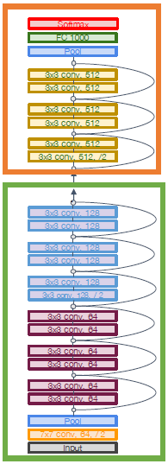
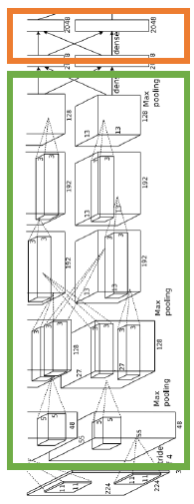
Fast R-CNN
Bbox
Bbox
Bbox
Category and box
transform per region
Source: R. Girshick
Class
Class
Class
Per-region networks
Per-Region network is
relatively lightweight
RoI pooling layer (crop + resize features)
Regions of Interest (RoIs) from a proposal method
Conv5 feature map of image
ConvNet
Run whole image through ConvNet
“Backbone” network: AlexNet, VGG, ResNet, etc.
Most of the computation
happens in backbone network; this saves work for overlapping region proposals
Example: For ResNet, last stage is used as per-region
network; the rest of the network is used as backbone
Example: When using AlexNet for detection, five conv layers are used for backbone and two FC layers are used for per-region network
Input image
Girshick, “Fast R-CNN”, ICCV 2015.
Slide: Johnson
Notes:
The features are also sent to a linear regressor that improves object localization.
The components outlined in purple are “post hoc” in the sense that they are learned after the convnet weights are trained and forever frozen.

Slide 28
Fast R-CNN
Bbox
Bbox
Bbox
Category and box
transform per region
Source: R. Girshick
Class
Class
Class
Per-region networks
RoI pooling layer (crop + resize features)
How to crop
features?
Regions of Interest (RoIs) from a proposal method
Conv5 feature map of image
ConvNet
Run whole image through ConvNet
“Backbone” network: AlexNet, VGG, ResNet, etc.
Input image
Girshick, “Fast R-CNN”, ICCV 2015.
Slide: Johnson
Notes:
The features are also sent to a linear regressor that improves object localization.
The components outlined in purple are “post hoc” in the sense that they are learned after the convnet weights are trained and forever frozen.

Slide 29
Cropping Features: RoI Pool
Project object proposal onto features
“Snap” to
grid cells
Divide into 2x2
grid of (roughly)
equal subregions
Max-pool within
each subregion
CNN
Region Features
(here 512 × 2 × 2; in practice, e.g., 512 × 7 × 7)
Input Image
(e.g., 3 × 640 × 480)
Image Features
(e.g., 512 × 20 × 15)
Region features always the
same size even if input
regions have different sizes!
Problem: Slight misalignment due to
snapping; different-sized subregions is weird
Slide: Johnson

Slide 30
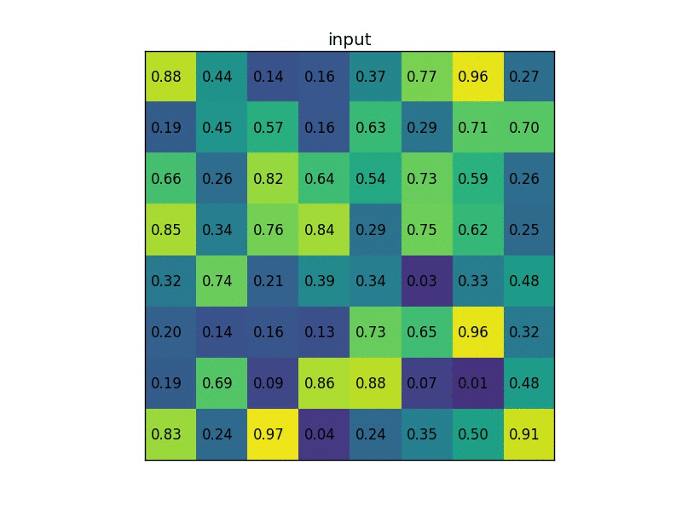
RoI Pooling Illustration
https://deepsense.ai/region-of-interest-pooling-explained/

Slide 31
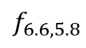
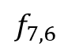
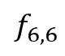
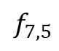
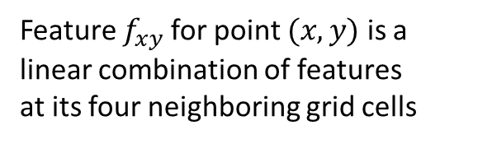
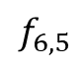
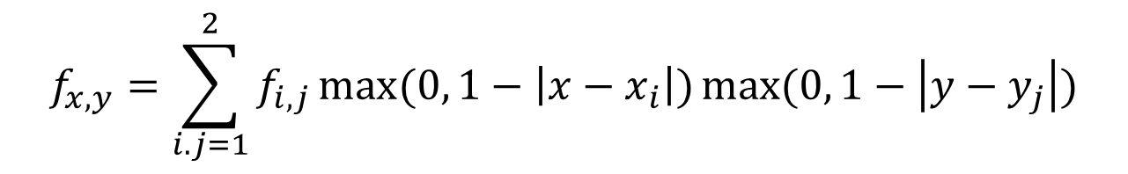
Cropping Features: RoI Align
Divide into equal-sized subregions
(may not be aligned to grid!)
Project object proposal onto features
No snapping.
Sample features at
regularly-spaced points
in each subregion using
bilinear interpolation
CNN
$$f_{6,5}$$
$$f_{7,5}$$
$$f_{6.6,5.8}$$
$$f_{6,6}$$
$$f_{7,6}$$
Input Image
(e.g., 3 × 640 × 480)
Image Features
(e.g., 512 × 20 × 15)
Feature $f_{xy}$ for point $(x, y)$is a
linear combination of features
at its four neighboring grid cells
$$f_{x,y}=\sum_{i.j=1}^{2}{f_{i,j}}\max{(0, 1−\left|x−x_{i}\right|)\max{(0, 1−\left|y−y_{j}\right|)}}$$
This is differentiable! Upstream gradient for sampled feature will
flow backward into each of the four nearest-neighbor grid points
He et al, “Mask R-CNN”, ICCV 2017.
Slide: Johnson

Slide 32
Cropping Features: RoI Align
Divide into equal-sized subregions
(may not be aligned to grid!)
Project object proposal onto features
No snapping.
Sample features at
regularly-spaced points
in each subregion using
bilinear interpolation
CNN
After sampling, maxpool in each region
Region features
(here 512 x 2 x 2;
In practice e.g., 512 x 7 x 7)
Input Image
(e.g., 3 × 640 × 480)
Image Features
(e.g., 512 × 20 × 15)

Slide 33
Fast R-CNN vs. “Slow” R-CNN
“Slow” R-CNN: Apply differentiable cropping to shared image features
Category and box
transform per region
Source: R. Girshick
Fast R-CNN: Apply differentiable
cropping to shared image features
Bbox
Bbox
Bbox
Class
Class
Class
Bbox
SVMs
Bbox
SVMs
ConvNet
Forward each region through ConvNet
Per-region networks
Bbox
SVMs
ConvNet
ConvNet
RoI pooling layer (crop + resize features)
Regions of Interest (RoIs) from a proposal method
Warped image regions
Conv5 feature map of image
ConvNet
Run whole image through ConvNet
“Backbone” network: AlexNet, VGG, ResNet, etc.
Input image
Input image
Girshick, “Fast R-CNN”, ICCV 2015.
Slide: Johnson
Notes:
The features are also sent to a linear regressor that improves object localization.
The components outlined in purple are “post hoc” in the sense that they are learned after the convnet weights are trained and forever frozen.

Slide 34
Fast R-CNN vs. “Slow” R-CNN
Training time (hours)
Testing time (seconds)
Problem: Runtime
dominated by
region proposals!
Recall: Region proposals computed by heuristic ”Selective Search” algorithm on CPU -- let’s learn them with a CNN instead!
Girshick et al, “Rich feature hierarchies for accurate object detection and semantic segmentation”, CVPR 2014.
He et al, “Spatial pyramid pooling in deep convolutional networks for visual recognition”, ECCV 2014
Girshick, “Fast R-CNN”, ICCV 2015
Slide: Johnson

Slide 35

Faster R-CNN: Learnable Region Proposals
Insert Region Proposal Network (RPN) to predict proposals from features
Classification loss
Bounding-box regression loss
…
Otherwise same as Fast R-CNN:
Crop features for each
proposal, classify each one
Classification loss
Bounding-box regression loss
RoI pooling
proposals
Region Proposal Network
feature map
CNN
Ren et al, “Faster R-CNN: Towards Real-Time Object Detection with Region Proposal Networks”, NIPS 2015
image
Source: R. Girshick, K. He

Slide 36
Cropping Features: RoI Pool
Imagine an anchor box of fixed size at each point in the feature map
Run backbone CNN to get features aligned to input image
CNN
Input Image
(e.g., 3 × 640 × 480)
Image Features
(e.g., 512 × 20 × 15)
Slide: Johnson

Slide 37
Cropping Features: RoI Pool
Imagine an anchor box of fixed size at each point in the feature map
Run backbone CNN to get features aligned to input image
Anchor is an object?
1 x 20 x 15
CNN
Conv
At each point, predict whether
the corresponding anchor contains an object (per-cell logistic regression, predict scores with conv layer)
Input Image
(e.g., 3 × 640 × 480)
Image Features
(e.g., 512 × 20 × 15)
Slide: Johnson

Slide 38
Cropping Features: RoI Pool
Imagine an anchor box of fixed size at each point in the feature map
Run backbone CNN to get features aligned to input image
Anchor is an object?
1 x 20 x 15
CNN
Conv
Box transforms
4 x 20 x 15
For positive boxes, also predict
a box transform to regress
from anchor box to object box
Input Image
(e.g., 3 × 640 × 480)
Image Features
(e.g., 512 × 20 × 15)
Slide: Johnson

Slide 39
Cropping Features: RoI Pool
Problem: Anchor box may
have the wrong size / shape
Solution: Use K different anchor boxes at each point!
Run backbone CNN to get features aligned to input image
Anchor is an object?
K x 20 x 15
CNN
Conv
Box transforms
4K x 20 x 15
At test time: sort all
K x 20 x 15 boxes by their score, and take the top ~300 as our region proposals
Input Image
(e.g., 3 × 640 × 480)
Image Features
(e.g., 512 × 20 × 15)
Slide: Johnson

Slide 40
Faster R-CNN: Learnable Region Proposals
Jointly train with 4 losses:
Classification loss
Bounding-box regression loss
…
RPN classification: anchor box is object / not an object
RPN regression: predict transform from anchor box to proposal box
Object classification: classify proposals as background /object class
Object regression: predict transform from proposal box to object box
Classification loss
Bounding-box regression loss
RoI pooling
proposals
Region Proposal Network
feature map
CNN
Ren et al, “Faster R-CNN: Towards Real-Time Object Detection with Region Proposal Networks”, NIPS 2015
image
Source: R. Girshick, K. He

Slide 41
Faster R-CNN: Test-Time Speed
Testing time (seconds)
Slide: Johnson

Slide 42
Faster R-CNN: Learnable Region Proposals
Question: Do we really
need the second stage?
Classification loss
Bounding-box regression loss
Faster R-CNN is a
Two-stage object detector
…
First stage: Run once per image
- Backbone network
- Region proposal network
Classification loss
Bounding-box regression loss
RoI pooling
Second stage: Run once per region
- Crop features: RoI pool / align
- Predict object class
- Prediction bbox offset
proposals
Region Proposal Network
CNN
Ren et al, “Faster R-CNN: Towards Real-Time Object Detection with Region Proposal Networks”, NIPS 2015
image
Source: R. Girshick, K. He

Slide 43
Single-Stage Object Detection
RPN: Classify each anchor as object or non-object
Single-Stage Detector: Classify each object as one of C categories (or background)
Run backbone CNN to get features aligned to input image
Anchor category
(C+1) x K x 20 x 15
CNN
Conv
Box transforms
4K x 20 x 15
Remember: K anchors at each position in
image feature map
Input Image
(e.g., 3 × 640 × 480)
Image Features
(e.g., 512 × 20 × 15)
Slide: Johnson

Slide 44
Single-Stage Object Detection
RPN: Classify each anchor as object or non-object
Single-Stage Detector: Classify each object as one of C categories (or background)
Run backbone CNN to get features aligned to input image
Anchor category
(C+1) x K x 20 x 15
CNN
Conv
Box transforms
C x 4K x 20 x 15
Sometimes use category-specific
regression: Predict different box transforms for each category
Input Image
(e.g., 3 × 640 × 480)
Image Features
(e.g., 512 × 20 × 15)
Redmon et al, “You Only Look Once: Unified, Real-Time Object Detection”, CVPR 2016
Liu et al, “SSD: Single-Shot MultiBox Detector”, ECCV 2016
Lin et al, “Focal Loss for Dense Object Detection”, ICCV 2017
Slide: Johnson

Slide 45
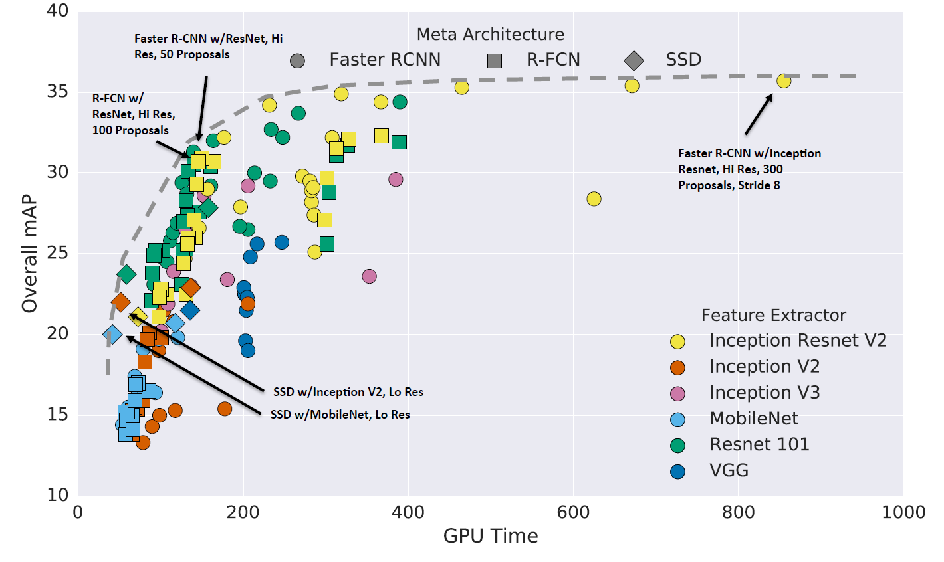
Object Detection: Lots of Variables
Takeaways:
Two stage method (Faster R-CNN) get the best accuracy, but are slower
Single-stage methods (SSD) are much faster, but don’t perform as well
Bigger backbones improve performance, but are slower
Diminishing returns for slower methods
Huang et al, “Speed/accuracy trade-offs for modern convolutional object detectors”, CVPR 2017
Slide: Johnson

Slide 46
Object Detection: Lots of Variables
These results are a few years old. Since then GPUs have gotten faster, and there is improved performance with many tricks:
Train longer!
Multiscale backbone: Feature Pyramid Networks
Better backbone: ResNeXt
Faster R-CNN
w/ResNet-101-FPN,
longer training
(63ms, 42.0 mAP)
Faster R-CNN
w/ResNeXt-101-
FPN, longer training
(120ms, 43.0 mAP)
Huang et al, “Speed/accuracy trade-offs for modern convolutional object detectors”, CVPR 2017
Slide: Johnson

Slide 47
Object Detection: Lots of Variables
Current leaderboard
winner: 59 mAP
Method ???
Runtime ???
Mask R-CNN
w/ResNeXt-152
(281 ms, 49.3 mAP)
These results are a few years old. Since then GPUs have gotten faster, and there is improved performance with many tricks:
Train longer!
Multiscale backbone: Feature Pyramid Networks
Better backbone: ResNeXt
Single-stage methods have improved
Very big models work better
Test-time augmentation pushes numbers up
Big ensembles, more data, etc.
Mask R-CNN w/ResNeXt-152 +Test-time augmentation
(? ms, 51.4 mAP)
RetinaNet (SSD-like)
w/ResNet-101
(80ms, 39.9 mAP)
https://competitions.codalab.org/competitions/20794#results
Huang et al, “Speed/accuracy trade-offs for modern convolutional object detectors”, CVPR 2017
Slide: Johnson

Slide 48
Object Detection: Open-Source Code
Object detection is hard! Don’t implement it yourself
TensorFlow Detection API:
https://github.com/tensorflow/models/tree/master/research/object_detection
Faster R-CNN, SSD, RFCN, Mask R-CNN
Detectron2 (PyTorch):
https://github.com/facebookresearch/detectron2
Fast / Faster / Mask R-CNN, RetinaNet
Slide: Johnson

Slide 49
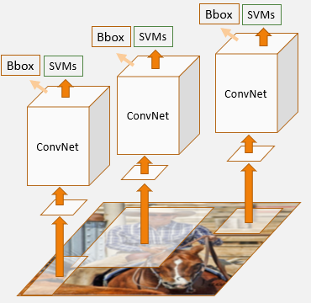
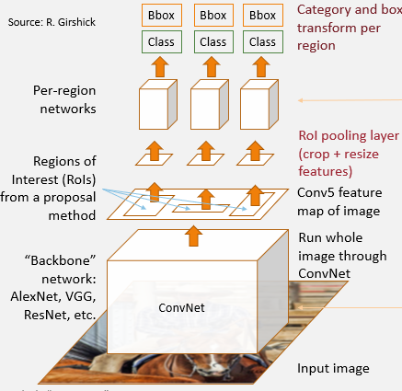
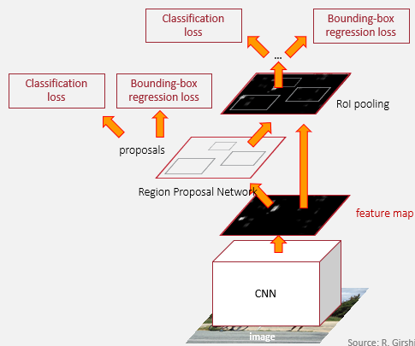
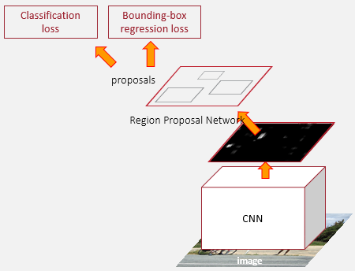
Summary
“Slow” R-CNN: Run
CNN independently
for each region
Fast R-CNN: Apply
differentiable
cropping to shared
image features
Faster R-CNN:
Compute proposals
with CNN
Single-Stage:
Fully convolutional
detector

Slide 50
Classification loss
Bounding-box regression loss
proposals
Region Proposal Network
CNN
image

